Slide 1
Business Analytics
Ebay
Report

Slide 2

Introduction
Next we will do an important review regarding the logistics and economic area of ​​eBay, as a company with exponential growth since its inception taking as a statistical base; around 4 years to make a comparison between each one to see their development and evolution.

Slide 3
<About ebay>
Present day:
EBay has a fairly bright financial picture, with $900 million in cash on hand, and has generated over $300 million cash flow over the course of 2019. Its return on equity is robust, as well. During the past year, the company has clocked in with a return on equity rate of 61%, meaning that for every $1 in share equity, the stock has produced 61 cents in profit.
Histroy
Originally called Auction web, eBay was founded by Omidyar on Labor Day weekend in 1995, when he listed his laser printer for $ 1. For a week, there were no takers, then bidders began weighing and driving the price of the battered printer up to $ 14.83. Immediately, Omidyar knew he was on to something big.

Slide 4
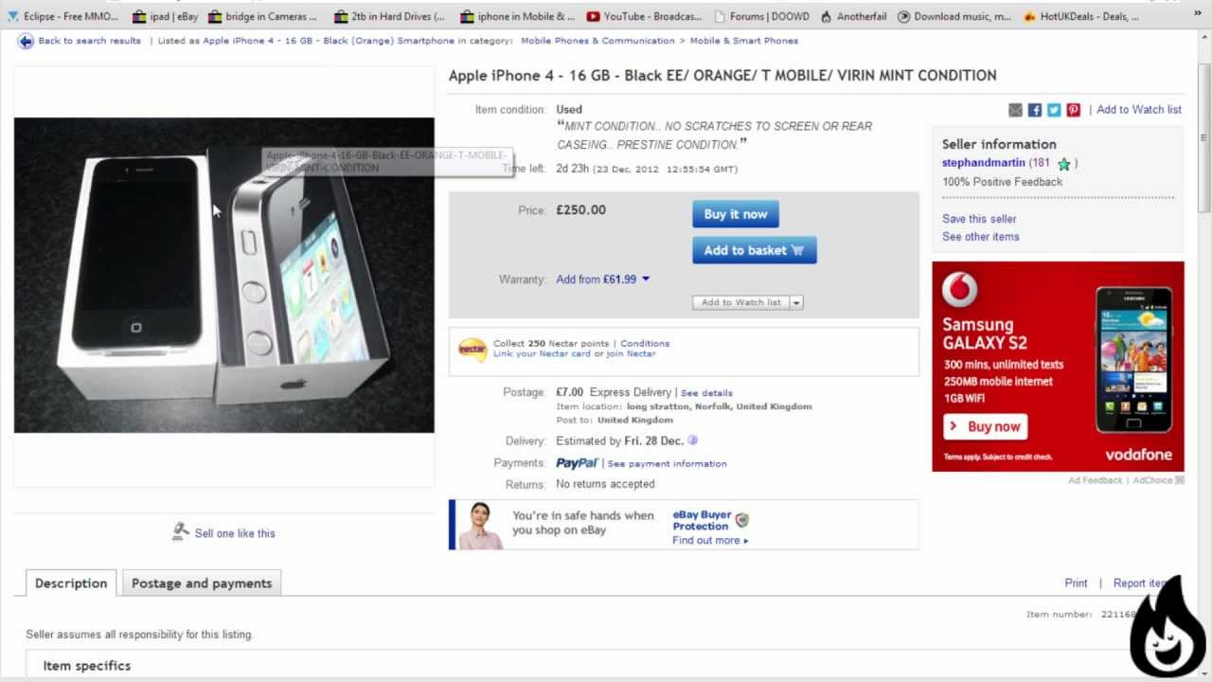
Ebay
What is ebay?
eBay is a site for the auction and electronic commerce of products through the internet. It is one of the pioneers in this type of transaction, having been founded on September 3, 1995.

Slide 5
Let's get in numbers
What year between 2013, 2014, 2015, and 2016 saw the highest total revenue? and the lowest?the total revenue about the 4 years? and the average? Like business of information technology.
It was the year 2016 with the best revenue with $8,979,000,000.
And pointing out 2013 as the year with the lowest revenue compared to the following years.
The 4 years averaged a total of $8,654,500,000.
Between the 4 years they add up to a total of $34,618,000,000 of revenue.
Note: In the following figure we can see how these answers are manifested 1.0.

Slide 6
Figure 1.0
Ticker Symbol | Years | Period Ending | Total Revenue
EBAY | Year 1 | 12/31/2013 | $8,257,000,000
EBAY | Year 2 | 12/31/2014 | $8,790,000,000
EBAY | Year 3 | 12/31/2015 | $8,592,000,000
EBAY | Year 4 | 12/31/2016 | $8,979,000,000
Maximum | $8,979,000,000 | Total Sum From all years | $34,618,000,000
Minimum | $8,257,000,000 | Average from all years | $8,654,500,000

Slide 7
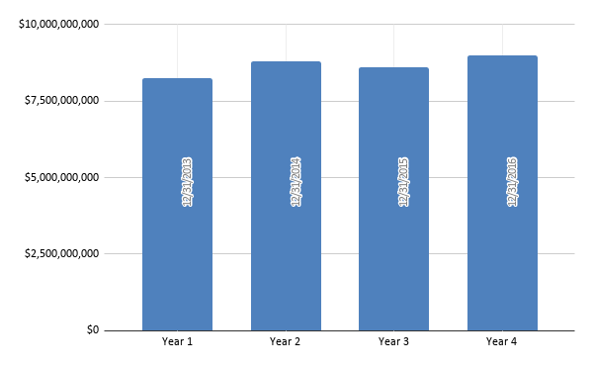
Notes:
Figure 1.2

Slide 8
Description of the previous figure
In the graph we can see the punctuation of the variability that exists with respect to the economic growth of the company throughout the 4 years mentioned, starting from $ 0 where the company has maintained an apparent stability above $ 7,500,000,000.

Slide 9
Second part of the report
Notes:
Task 2:

Slide 10
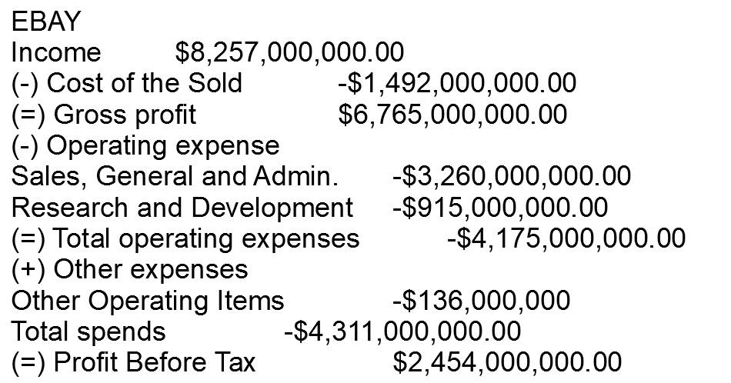
Profit and Loss Status As of December 31, 2013

Slide 11
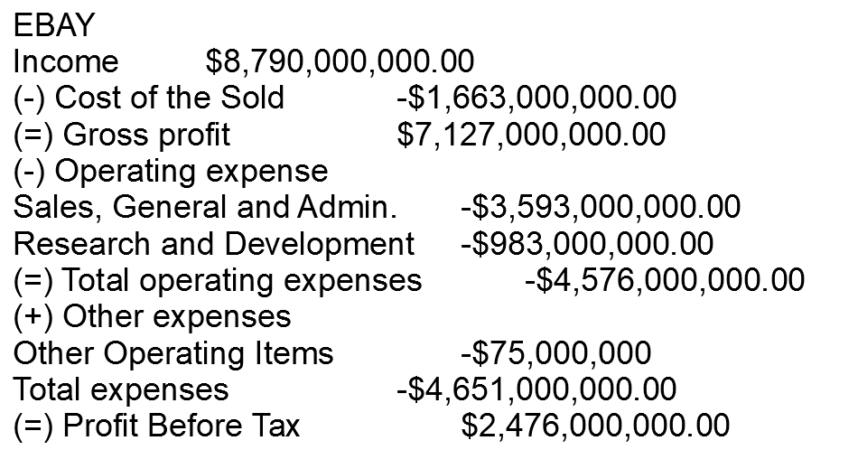
Profit and Loss Status As of December 31, 2014

Slide 12
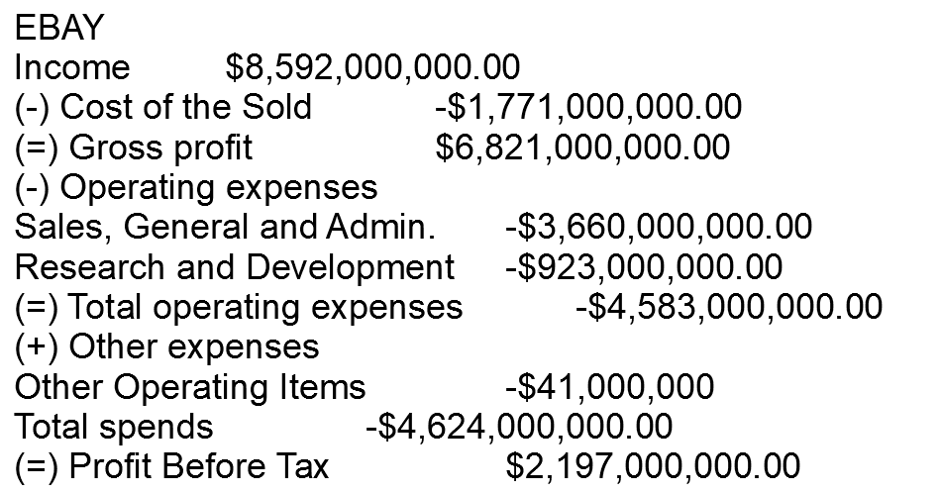
Profit and Loss Status As of December 31, 2015

Slide 13
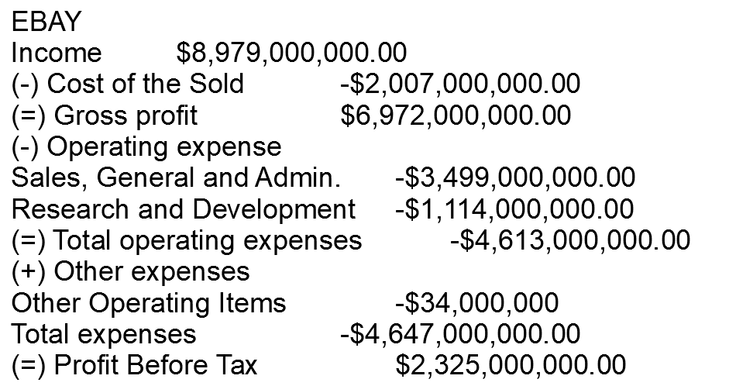
Profit and Loss Status As of December 31, 2016

Slide 14
Company growth and profit chart
Years | Utility | Increase
1 | $2,454,000,000.00 | 0%
2 | $2,476,000,000.00 | 1%
3 | $2,197,000,000.00 | -11%
4 | $2,325,000,000.00 | 6%
Average | $2,363,000,000.00 | -1%
In this table we rate the utility of the company in the years indicated, and the growth with respect to the aforementioned period of time.

Slide 15
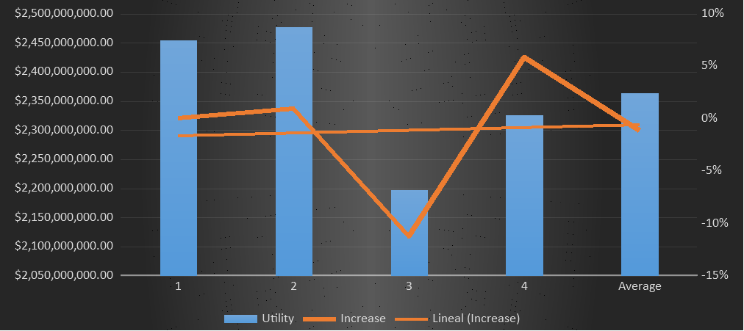
Graphic company growth and profit chart

Slide 16
Conclusions
The mean in the ebay company regarding GICS Sector services represents an incredible amount of $ 8,654,500,000, thus resulting in a positive response as a great investment in a 4-year term.
The median obtained in 4 years as total income is $ 8,691,000,000, thus representing our earnings in an investment in GICS Sector, an interesting purpose for an integral investment would be convenient, and with this data to maintain an idea of ​​what the income would be in this type of technological investment.
Regarding the standard deviation, we see that its data represents a total of $ 267,195,153 with respect to the mean, which is about $ 8,654,500,000, we can see that the data is grouped close to the mean, thus obtaining the expected data.
Now, specifying the range, we note that the maximum value of revenue is $ 8,979,000,000 that includes the year 2016 with respect to the minimum value that is around $ 8,257,000,000 number obtained in 2013.

